Slide 1
NAFTA through a Product Space Lens
Belinda Román, PhD
Agent-based Computational Economics Western Economic Association International Annual Meeting Seattle, WA July 1, 2013
Funding from
Notes:
Thank ABS for opportunity to present research.

Slide 2
Key Ideas
A country is what it produces
Production reveals something
Future opportunities for growth and development derive from what a country produces
Complexity is important for future opportunities
Network theory can be used in this type of analysis
Notes:
International trade research tends to use the monetary value of imports and exports to study trade relations. In this research, the focus is on what a country or group of countries produces in order to focus on production and its requirements as a means of understanding long-term economic growth and development.
Why this is important? A review of research into the economic development of countries reveals an important problem: Resource- abundant countries do not necessarily benefit from their natural endowments whilst other countries whose resources were considered limited seem to advance, and rather rapidly. An example might be Singapore or Taiwan, two countries that have demonstrated remarkable economic development despite limited resources (except labor).
The literature suggests studies that focus solely on monetary values miss other aspects of the development picture. Additionally, and perhaps more relevant to Associate of Borderland Studies, is the process of integration embodied in trade agreements such as NAFTA in which national boundaries are subsumed.

Slide 3
Theoretical Framework
Orthodoxy – Comparative Advantage
Hechscher – Olin extension
Hausmann and Hidalgo (2011)
Revealed Comparative Advantage (Balassa 1965)
Notes:
Orthodox international economic theory holds that David Ricardo’s conceptualization of comparative advantage determines which products two countries will trade. The Hechscher- Ohlin extension of this idea adds that factor intensity influences in the goods traded such that countries trade those products that employ a country’s relatively abundant factor of production.
For example, U.S.A might produce and trade to Canada and Mexico products that use its relatively abundant capital resources in exchange for products that the other countries might produce with their relatively abundant labor and/or natural resource factors, assuming these are the original endowments. This formulation allows us to give further thought to the notion of “skills” embodied in the products a country exports. For example, capital intensive exports suggest the existence of a social infrastructure, along with appropriate equipment, machinery, and skills specific to the production of a particular traded resource-intensive product.
The work of Ricardo Hausmann and Cesar Hidalgo (2007) is a corner stone of this approach. In their work, they use a mix of international trade and income data to determine the Revealed Comparative Advantage (RCA) of a country as expressed in their trade relations coupled with the purchasing power parity of the income generated by the exports. This information is processed a number of times until the researchers produce network measures that allow a visualization of the productive structure of the global economy and the intensity of trade between countries at a number of different levels.

Slide 4
Data and Its Interpretation
NAFTA area exports by country and in total
NAICS
3-digit level
Revisions in 2002 and 2006, and 2012
Years 2000 - 2012
Notes:
The Hidalgo et. al. research applies its principles to world trade data and the comparative advantage of nations. As explained above, the idea is international trade values are insufficient in describing long-term economic growth and development. Here I down-size their ideas and apply the methodology to the tri-lateral bloc of countries in the North American Free Trade Agreement (NAFTA).
The North American Industry Classification System (NAICS) replaced the Standard Industrial Classification (SIC) in 1999, the latter was used for over 60 years as a means of collecting information on the U.S. economy. As noted on the U.S. Census Bureau web site, SIC codes were used to group establishments engaged in producing and handling the same product or group of products.
The newer NAICS was developed using a production-orientated framework, such that establishments were grouped according to their primary activity. A benefit of this process is NAFTA-wide definitions of productive activities.
Representatives from all three countries agreed the codes - the U.S. Economic Classification Policy Committee, Statistics Canada and the Instituto Nacional de Estadistica y Geografia. This particular system uses 3- and 6-digit codes rather than 4-digit codes found in the SIC. The first iteration of the NAICS was in 2000 with revisions issued in 2002 and 2007 (http://www.census.gov/).

Slide 5
Sample NAICS Codes
Table 1 – Three-Digit Codes Attribute and Industry
3-Digit NAICS Code |  | Industry
111 |  | Agricultural Products
112 |  | Livestock and Livestock Products
113 |  | Forestry Products
114 |  | Fish, Fresh, Chilled, or Frozen and Other Marine Products
211 |  | Oil And Gas
212 |  | Minerals and Ores
311 |  | Food and Kindred Products
312 |  | Beverages and Tobacco Products
313 |  | Textiles and Fabrics
314 |  | Textile Mill Products
315 |  | Apparel and Accessories
316 |  | Leather and Allied Products
321 |  | Wood Products
322 |  | Paper
323 |  | Printed Matter and Related Products, Nesoi
324 |  | Petroleum and Coal Products
325 |  | Chemicals
326 |  | Plastics and Rubber Products
327 |  | Nonmetallic Mineral Products
331 |  | Primary Metal Manufacturing
Notes:
Comment on Codes:
Up to 211 agriculture
311 – 511 manufacturing
511 added in 2002
Other codes are services that missing values in 2, 4, 6, 7, and 8. These are service-related. In other words, the work I present is only on goods.

Slide 6
Calculating RCA
∑ 3-Digit NAICS _{Export-Country} ________________________
∑ All 3-Digit NAICSC _{All Exports-Country}
_____________________________________
=
RCA _{Country NAFTA}
∑ 3-Digit NAICS _{Export Regional} ________________________
∑ All 3-Digit NAICSC _{All} _{Exports} _{Regional}
All values in U.S. Current Dollars
Notes:
Explain equation

Slide 7
RCA for US
Revealed Comparative Advantage | Column1 | Column2 | Column3
US | 2000 | 2006 | 2012
'111' | 0.6725 | 1.0007 | 0.9998
'112' | 27.4655 | 0.9450 | 0.7047
'113' | 163.4017 | 0.9858 | 1.1481
'114' | 27.1679 | 0.9885 | 1.0046
'211' | 12.3637 | 0.8296 | 0.4898
'212' | 0.2986 | 1.0014 | 1.0001
'311' | 5.3462 | 0.9992 | 1.0008
'312' | 127.0318 | 0.2982 | 0.6337
'313' | 456.4508 | 0.3938 | 1.6121
'314' | 0.3050 | 1.0009 | 1.0002
'315' | 2.1557 | 1.0006 | 0.9995
'316' | 0.9681 | 0.9999 | 0.9980
'321' | 2.9940 | 1.0010 | 1.0028
'322' | 2.1880 | 1.0009 | 1.0011
'323' | 7.2700 | 1.0004 | 1.0043
'324' | 90.3254 | 0.9290 | 1.1295
'325' | 13.1904 | 0.9782 | 1.0293
'326' | 34.9757 | 0.9479 | 1.0058
'327' | 2.7964 | 0.9991 | 1.0000
'331' | 1.8746 | 0.9998 | 0.9998
Notes:
Comment on RCA

Slide 8
Results
Three screen shots
Graphs show points at which RCA ≥ 1
Yearly comparisons
2000
2006
2012
Notes:
Introduce next slide with images

Slide 9
2000
2005
2012
Notes:
Note above line implies RCA
Below Implies no RCA
Not Groupings of comparative advantages

Slide 10
Comments on Product Space
Grouping of RCA suggest something about NAFTA area production
In 2000 greater dispersion
Also RCA changing for countries
How does this relate to growth and development?
More complex tasks require higher skills
Skills transitivity
Agricultural Product vs. Manufacturing Production
Implications for employment and wages
Implications for each country and region

Slide 11
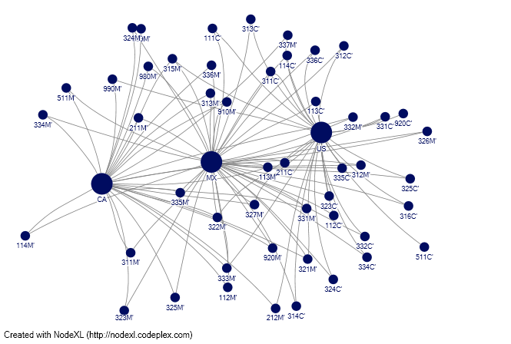
NAFTA 2000

Slide 12
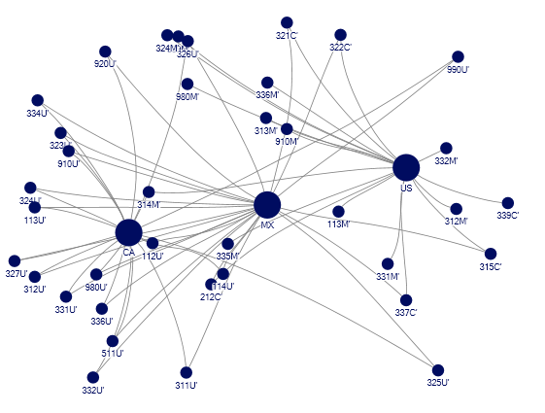
NAFTA 2006

Slide 13
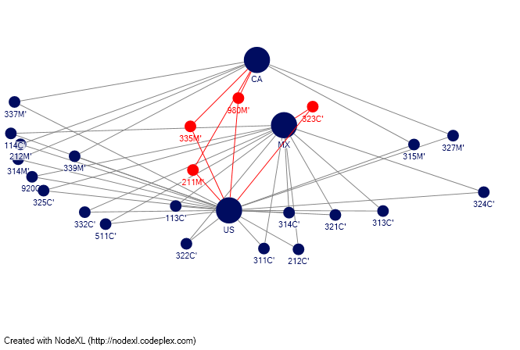
NAFTA 2012
211 – Oil and Gas
212 – Mineral and Ore
311-- Food
314 – Textile production
335 – Electronics
339 – Misc
990 - NESOI
Notes:
In the 2012 NAFTA map I’ve circled a few points to show the clusters and patterns.
Mapping algorithm is Harel-Koren Multiscale which is force-direct algorithm. “Vertices that are closely related are placed closer together. K-cluster, vertices in a cluster are places such that distance between edges is shortest. Distance is shortest.
I want to draw attention to 335M, this represents Electronics, components, etc. To make the link back to the original idea behind this paper, a recent article in The Guardian noted that Mexico is experiencing a “boom” in the Aerospace industry with Canadian companies such as Bombardier having invested in a plant to build components for its jets. Mexico, the report cited Bombardier officials, has a educated labor force that can now handle this type of manufacturing plus it is very close to the U.S. destination market – Boeing…etc.

Slide 14
Next Steps in Research
Complete the RCAs for each year 2000 -2012
Perhaps expand to 6-digit
Reconcile inconsistences or missing values in some categories
Add/compare FDI by NAICS
Add/compare, if possible, immigration or changes in domestic employment structures.
Consolidate and map using networks

Slide 15
References
R. Hausmann and C. Hidalgo, 2011. "The network structure of economic output."
R. Hausmann & J. Hwang & D. Rodrik, 2007. "What you export matters."
B. Balassa, 1965, Revealed Comparative Advantage
C. Hidalgo, 2010, "The Dynamics of Economic Complexity and the Product Space over a 42 year period." U.S. Census Bureau (http://www.census.gov/)
Statistics Canada (http://www.statcan.gc.ca/start-debut-eng.html)
NAFTA Office of Mexico in Canada (http://www.nafta-mexico.org/)
S. Frederic, “Mexico Aims High”, The Guardian, June 25, 2013.
D. Harel and Yehuda Koren, “ Fast Multi-scale Method for Drawing Large Graphs”, 2001.

